Slide 1

Alvi Nikola Thesis Supervisor: George Papagiannakis Co-Supervisor: Manos Kamarianakis
CSD-3D: A Virtual and Interactive Computer Science Department

Slide 2
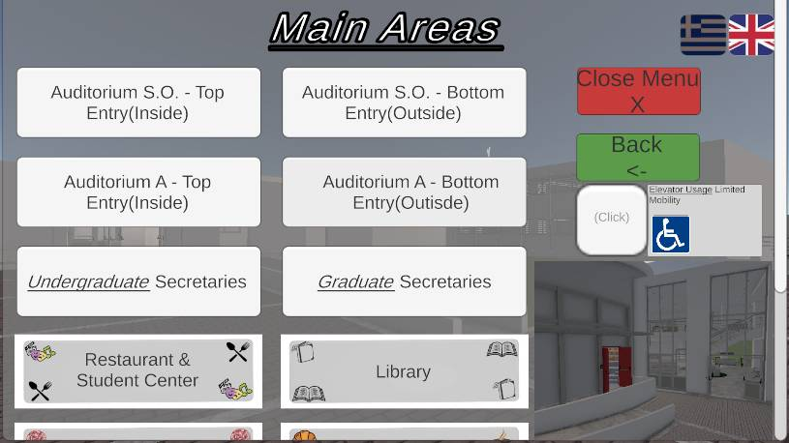
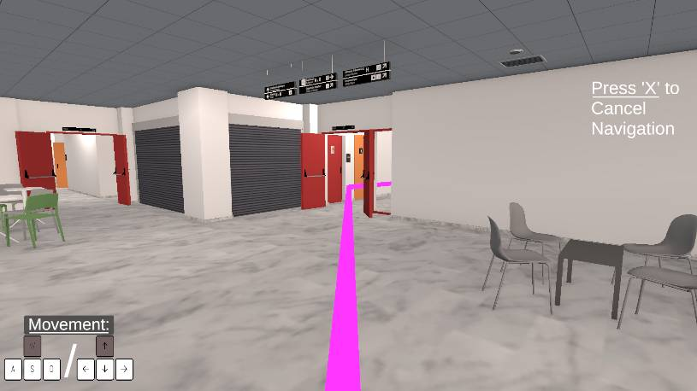
Purpose: 3D Interactive Navigation of Our Department
The purpose of this project is to provide users with a quick, easy, fun and interactive way to learn the Computer Science Department’s areas as well as navigate to dozens of provided destinations.

Slide 3
People who may be interested.
Students/Visitors with mobility difficulties who can’t traverse through the department at ease and need to find the (quickest & available) path to a chosen destination as well as have the ability to learn the area virtually.
New students/teachers who need to find the teaching classes that they will have to attend.
Parents, as well as their children, who are interested in being part of the department’s future and may possibly think about enrolling, can learn about the department’s history as well as its features virtually, without having to be present necessarily.
Foreign visiting students( i.e. Erasmus) who will want and need to learn the department’s areas.
Basically anyone who has an interest in attending the department and anyone who either wants or needs to learn how to traverse to the department’s halls and corridors.

Slide 4







Why? Who would be interested?
Students/Visitors with mobility difficulties who can’t traverse through the department at ease and need to find the (quickest & available) path to a chosen destination as well as have the ability to learn the area virtually.
New students/teachers who need to find the teaching classes that they will have to attend.
Parents, as well as their children, who are interested in being part of the department’s future and may possibly think about enrolling, can learn about the department’s areas as well as its features virtually, without having to be present necessarily.
Foreign visiting students( i.e. Erasmus) who will want and need to learn the department’s areas.
Anyone who has an interest in attending the department and anyone who either wants or needs to learn how to traverse to the department’s halls and corridors.

Slide 5
In other words
This project was created to accommodate the needs of multiple users, of various physical and mental differences and cultural backgrounds and fill multiple gaps in the field, since there is a lack of a 3D version of any department, accompanied with a fully functional navigational and academically informatory system.
Providing something unique, but most importantly, respectful to its users and helpful to our department, was of outmost importance and can not only help the department’s image, but also, be a genuine tool the department can utilize to provide a helping hand to a large percentage of its students.

Slide 6


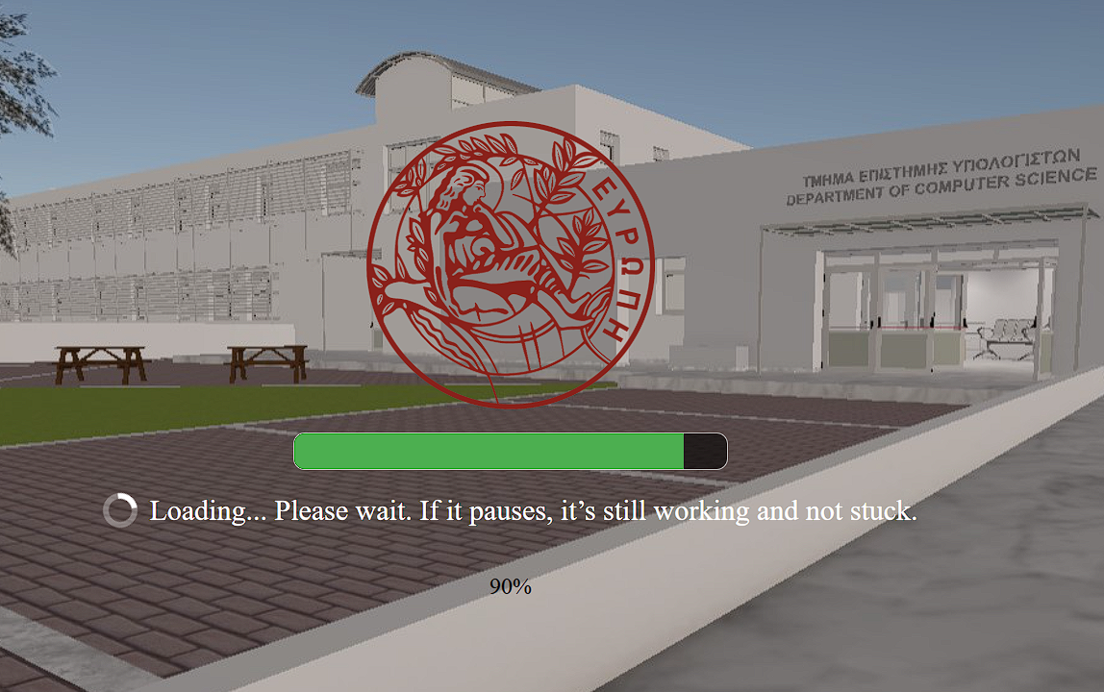





Easily Accessible
The program needs NO downloads or permanent APPS:
It is accessible via a website, on any browser, through WebGL. All the users have to do is load the page.
The program runs on both PCs and Mobile devices.
The program is around 98 MBs, loads initially in 15 seconds to 1 minute, depending on the device, and even less time the next times.
An Internet Connection and a device are the only things needed. Nothing else is required.

Slide 7

SketchUp
The 3D modeling software SketchUp was used to create the building from the ground up.
Hundreds of pictures and videos of the department, official top-views provided by the department’s website as well as Google Maps were used to capture every corner, inside and outside of the department, to create a realistic 1:1 digital version of the department.

Slide 8

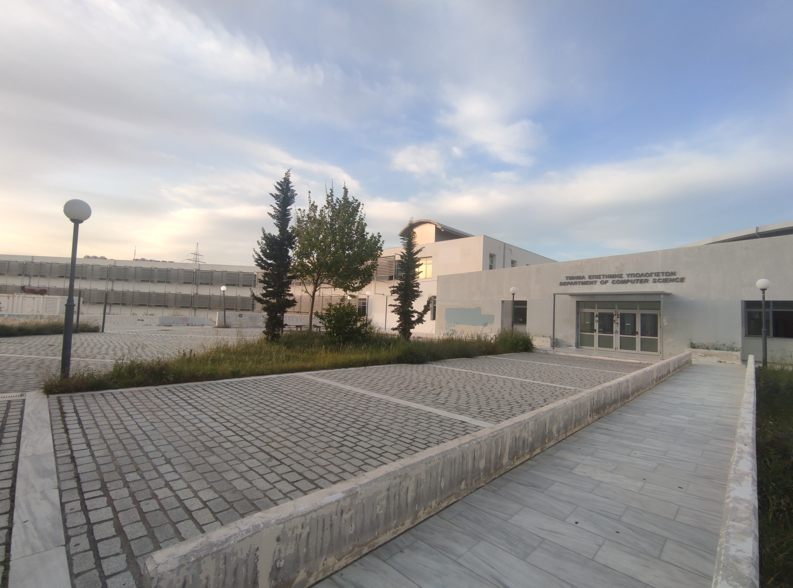

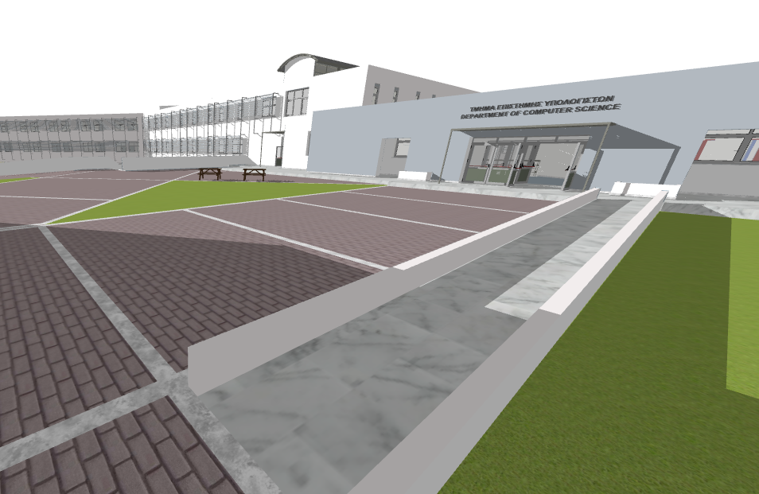
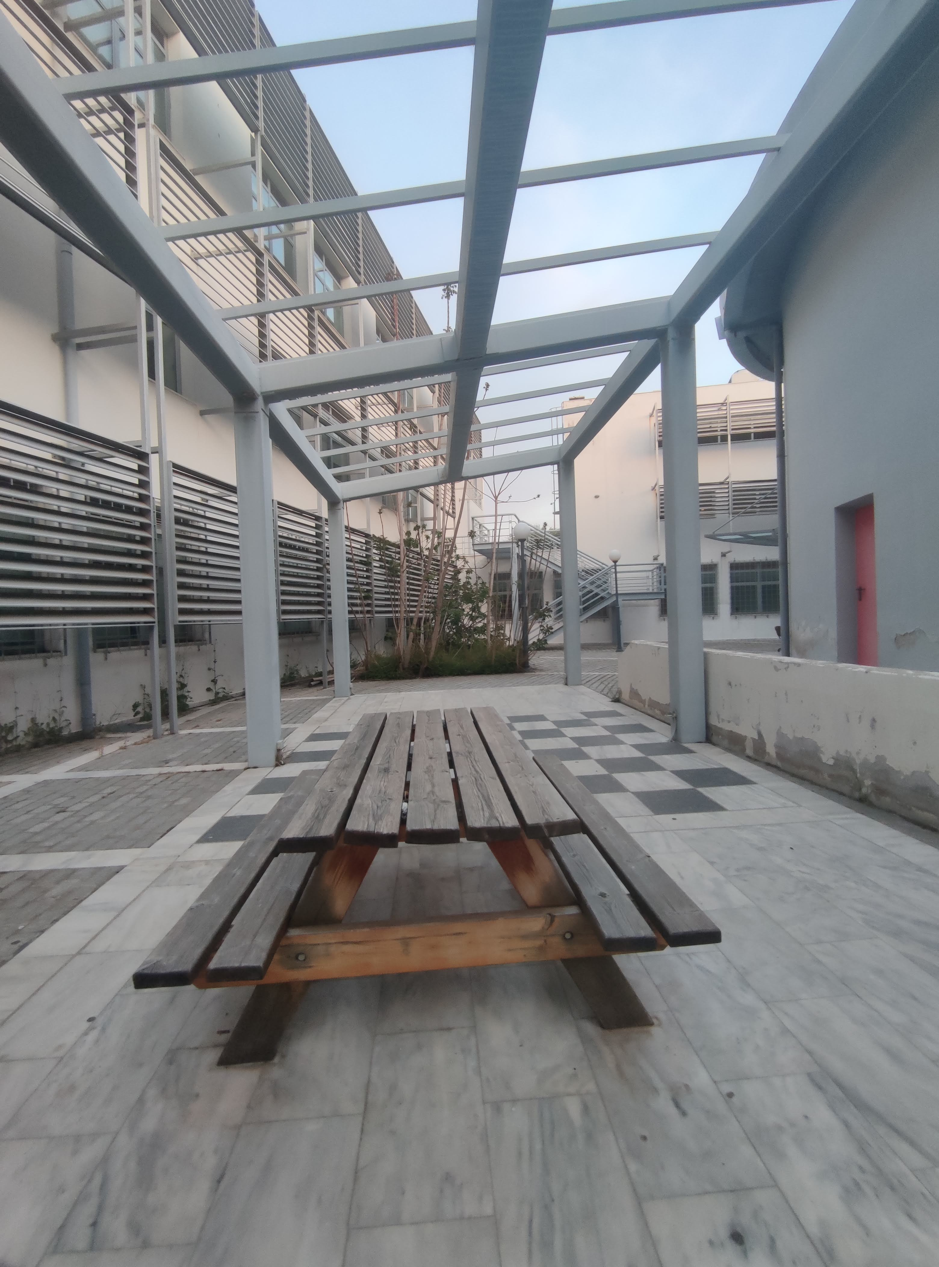
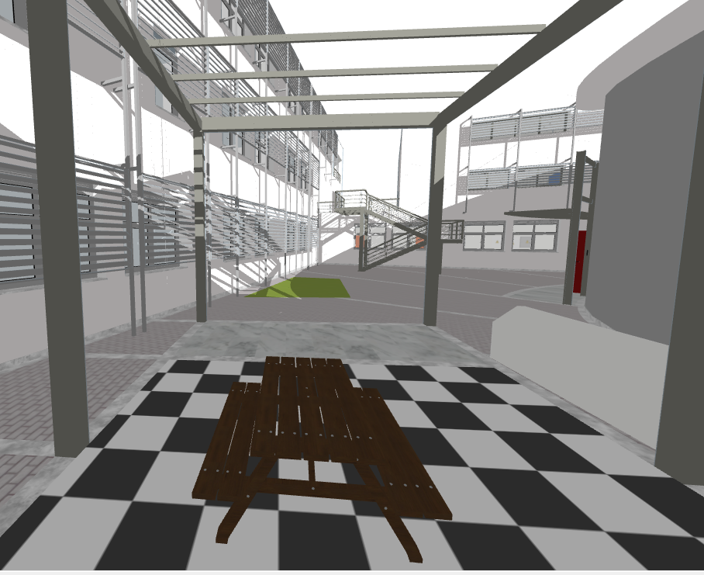
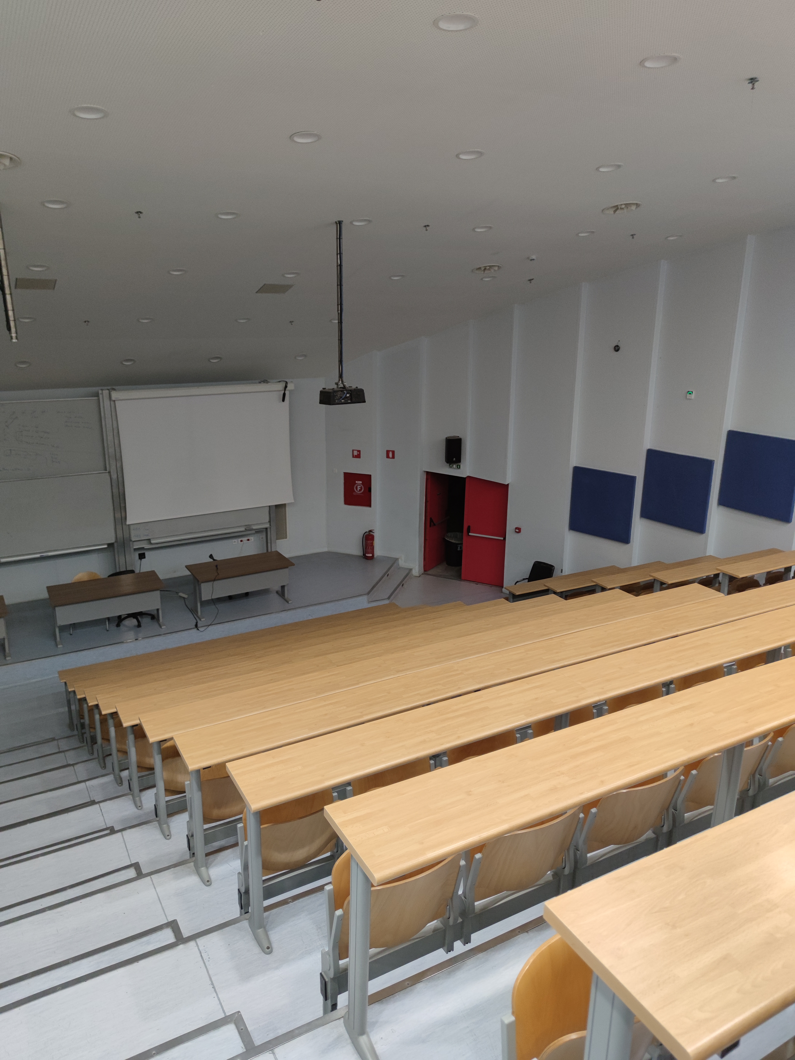
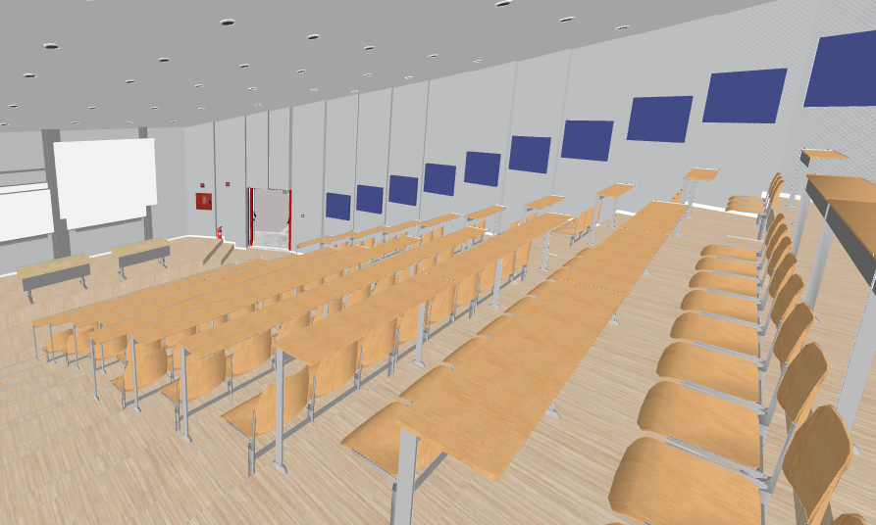
Real Photos --------------------→ SketchUp

Slide 9
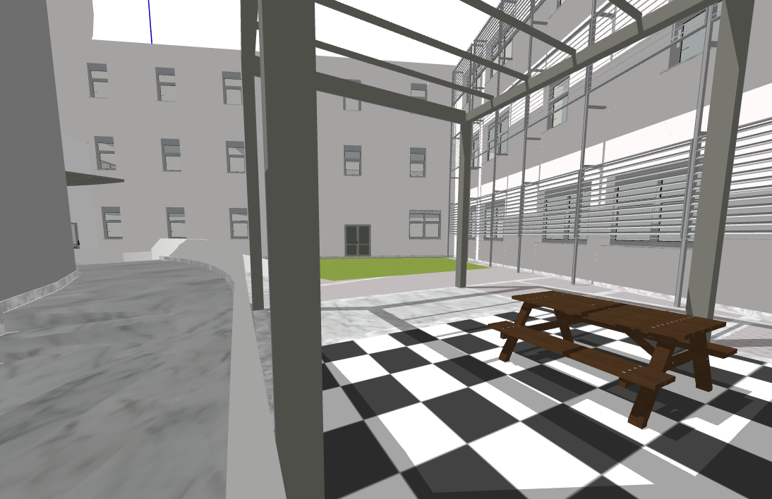
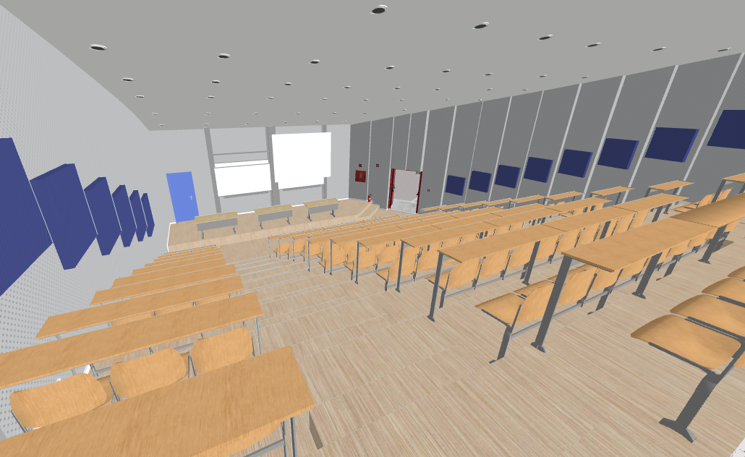
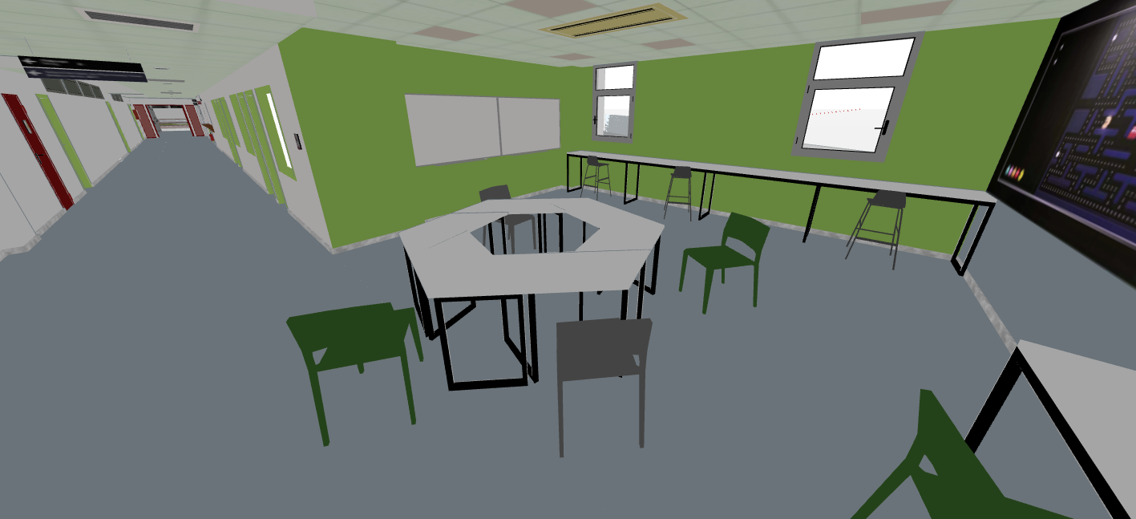
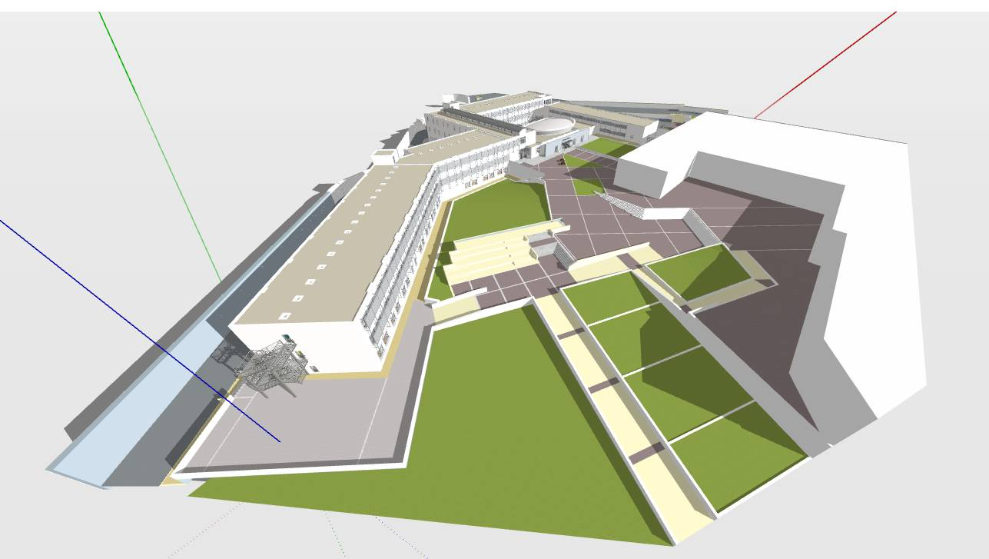
Some Images from SketchUp

Slide 10

Unity
After the Sketchup file was finished, it was exported and then imported inside Unity for the implementation of the functionalities.
Unity provided the foundations to create all functionalities and features of the program, which will go through in the next slides.
Coding, creation and manipulation of 3D items and 2D UI panels, time events etc. are some of the tools used in Unity to create the final product.

Slide 11

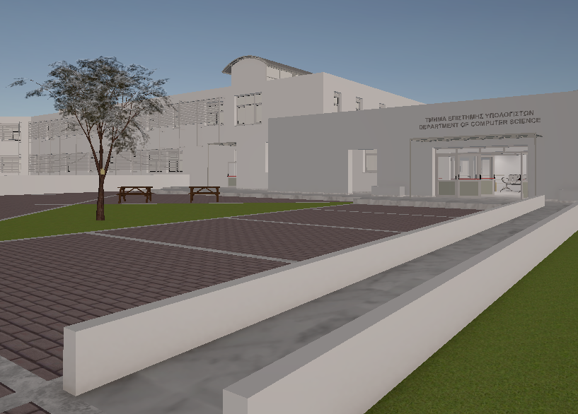
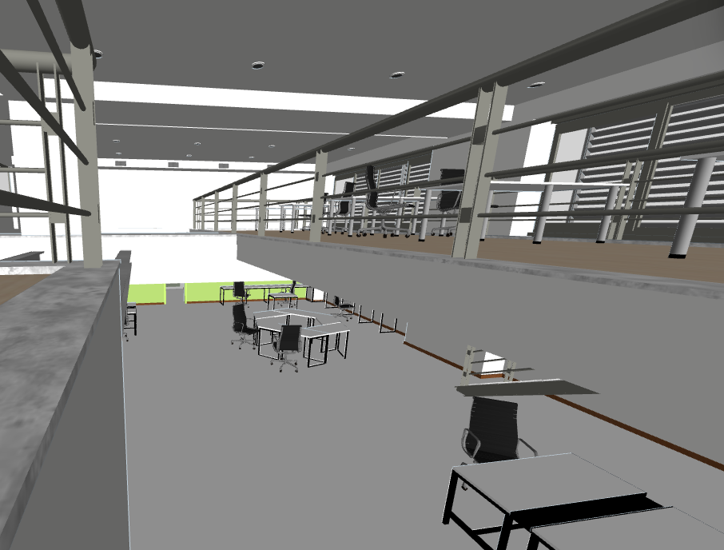
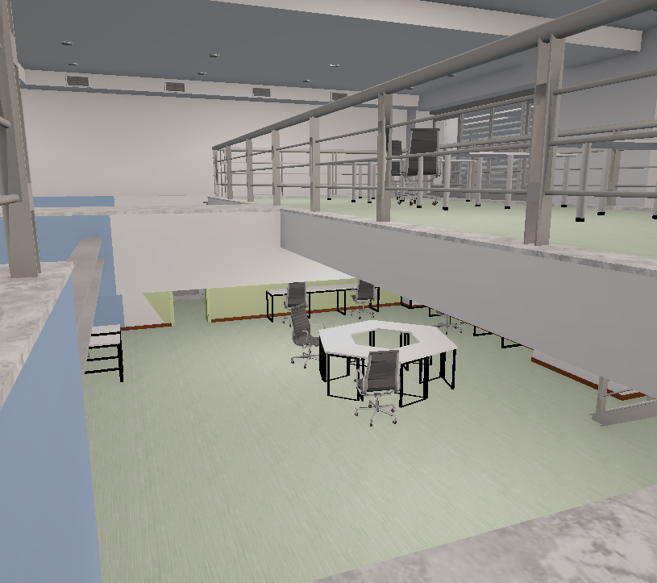
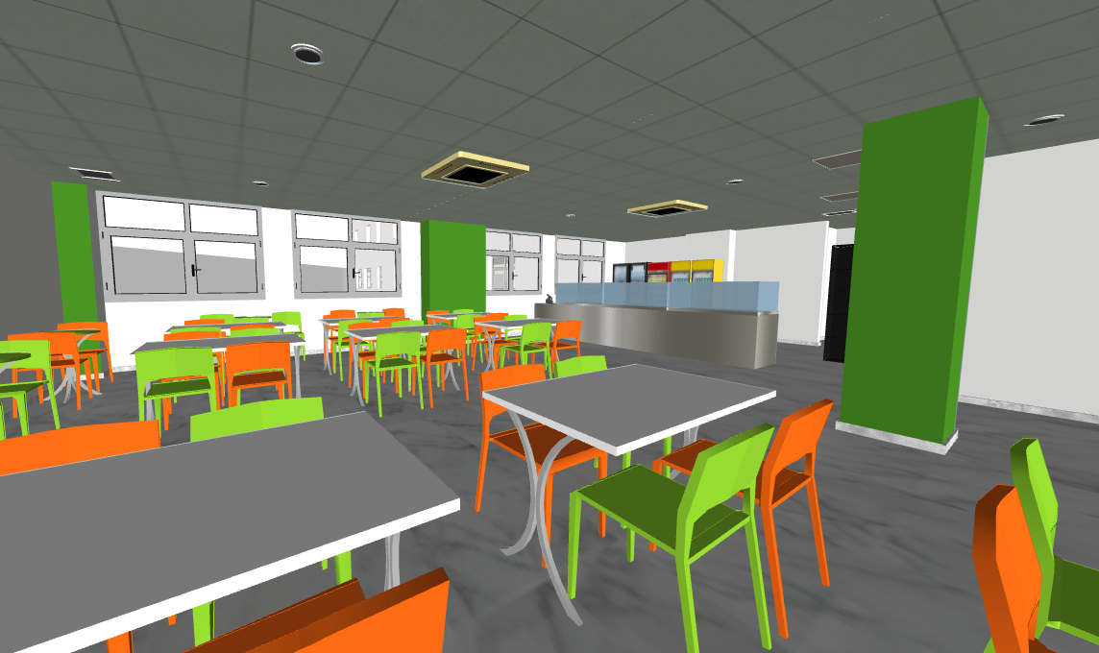
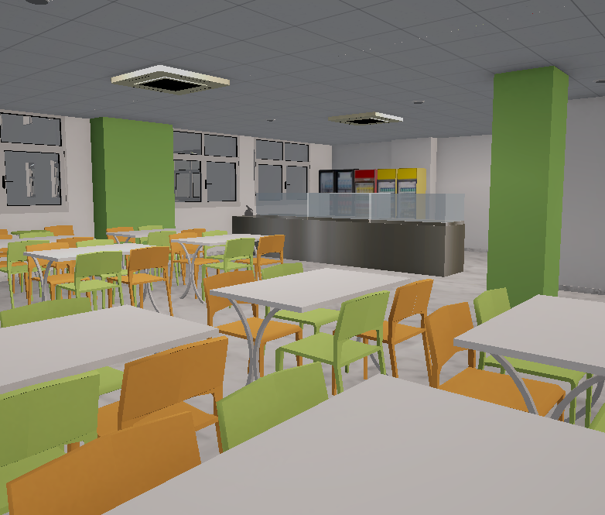
Sketchup ---------------------→ Unity

Slide 12
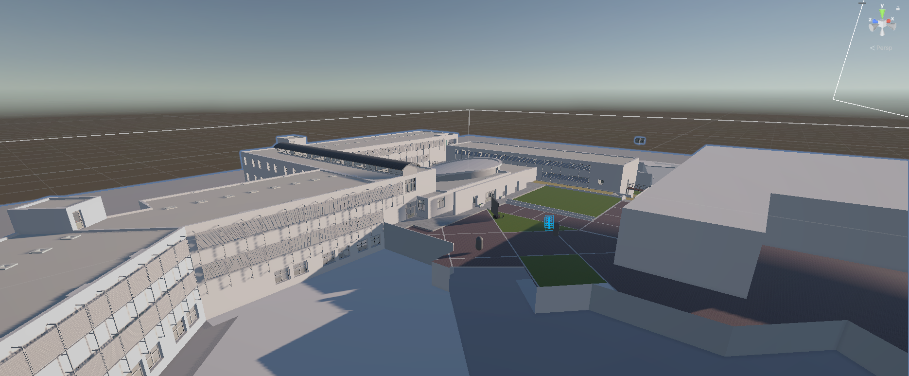
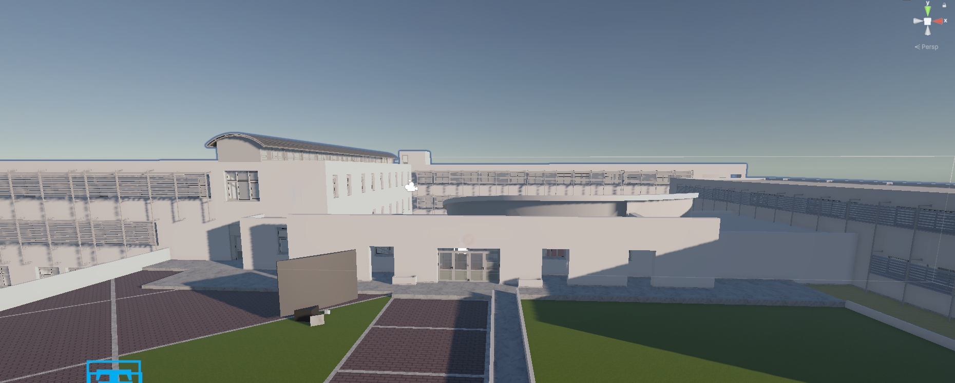
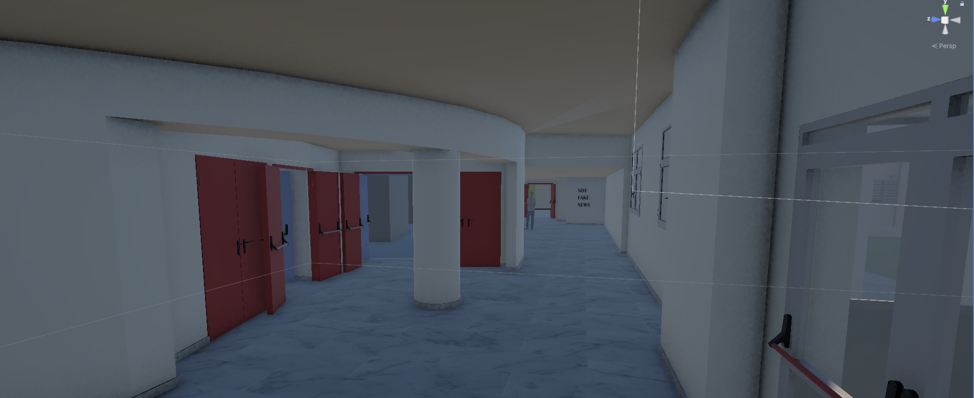
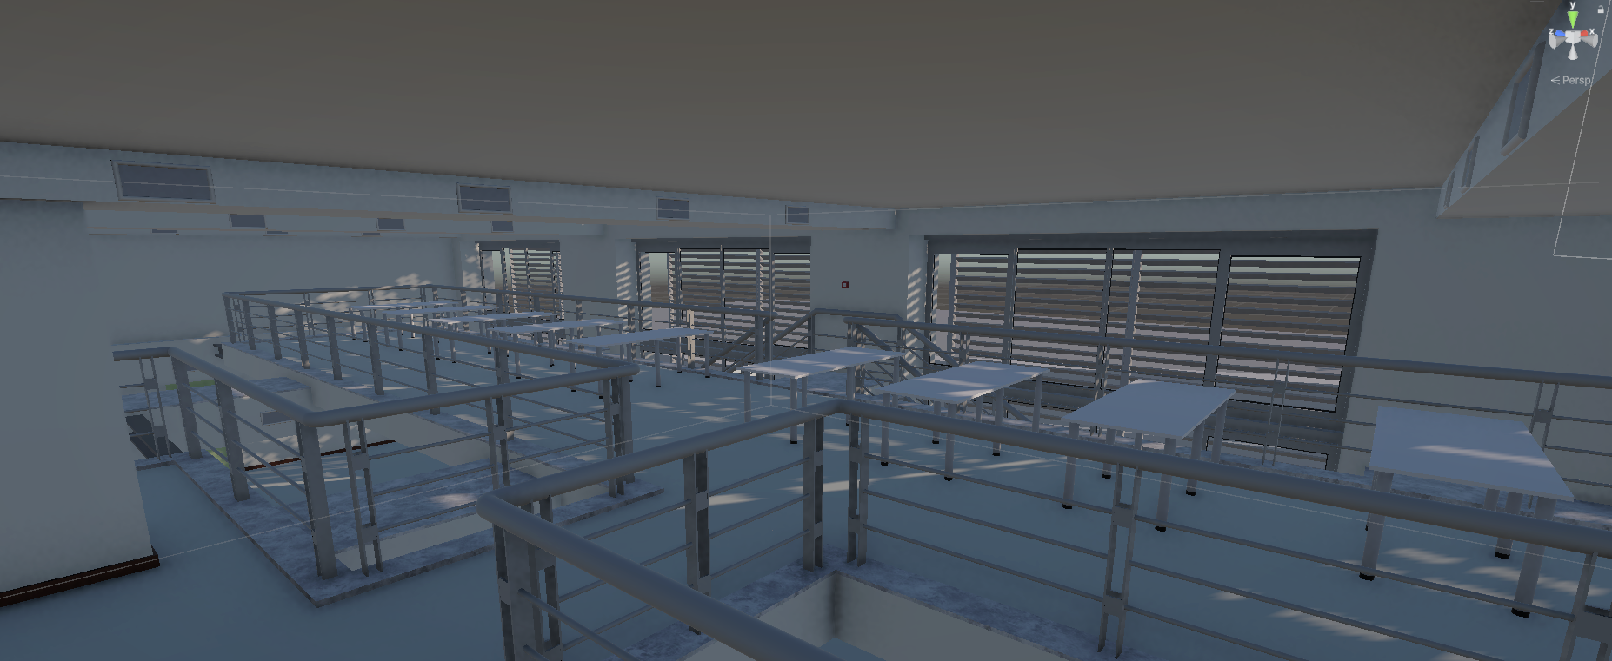
Some Images from Unity

Slide 13
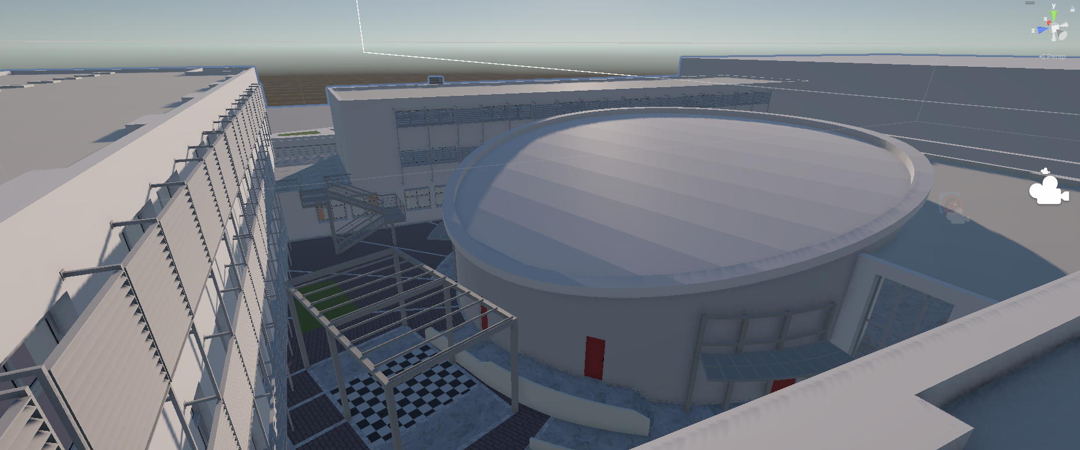
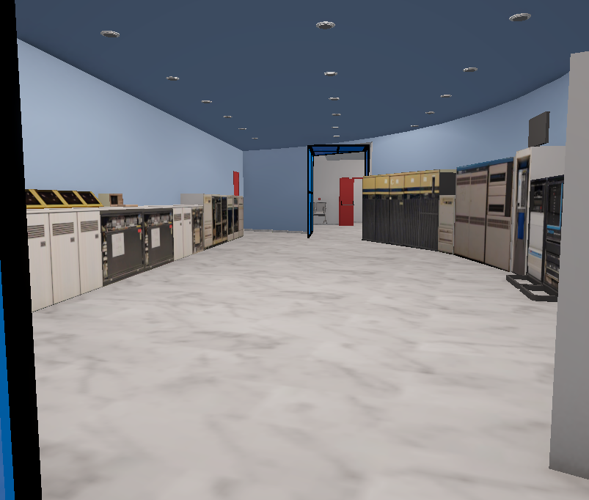
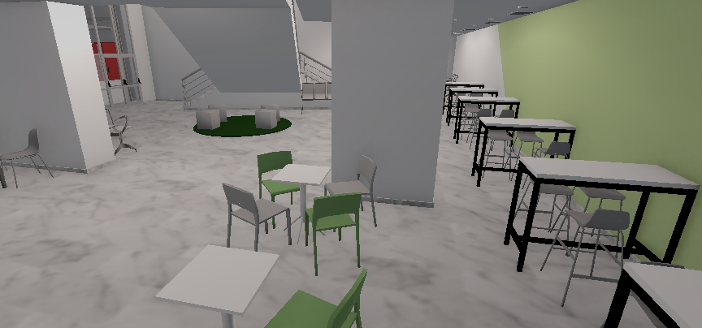
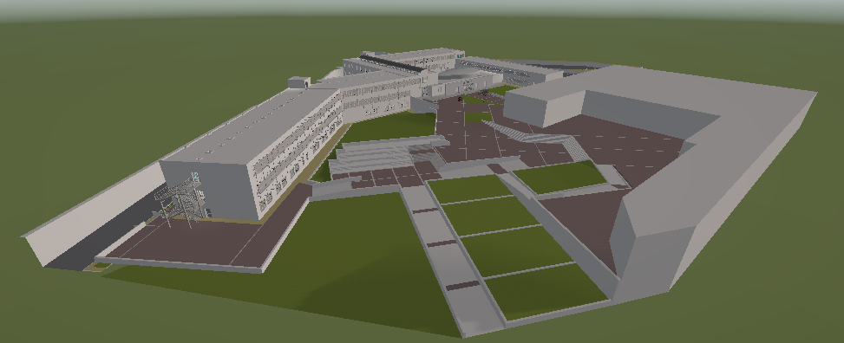

Slide 14
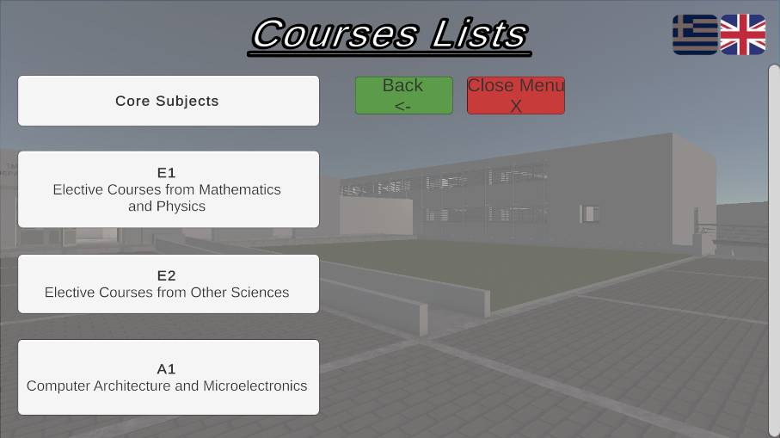
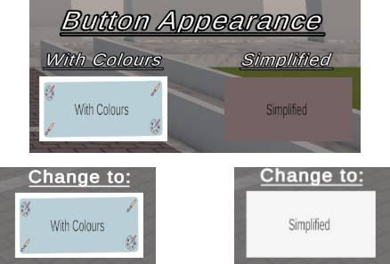
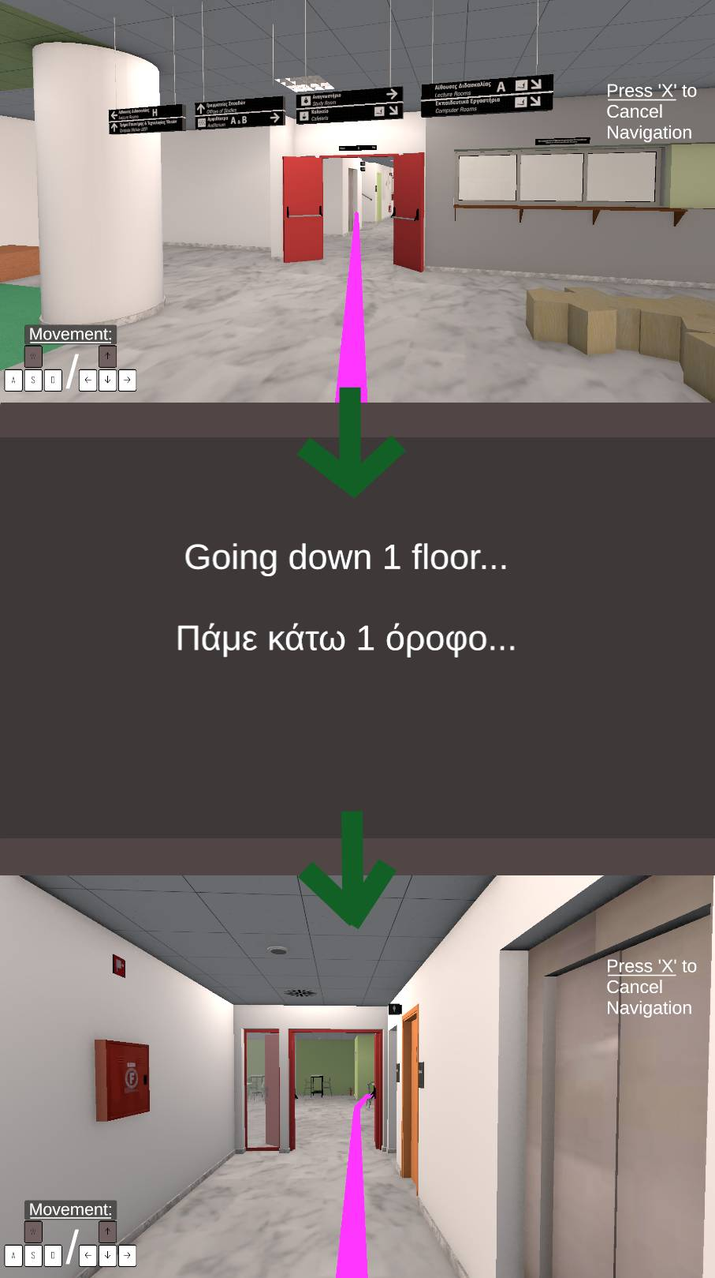
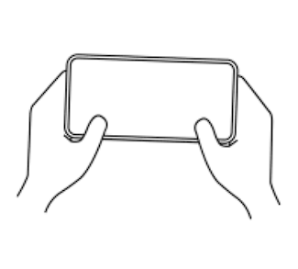

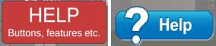
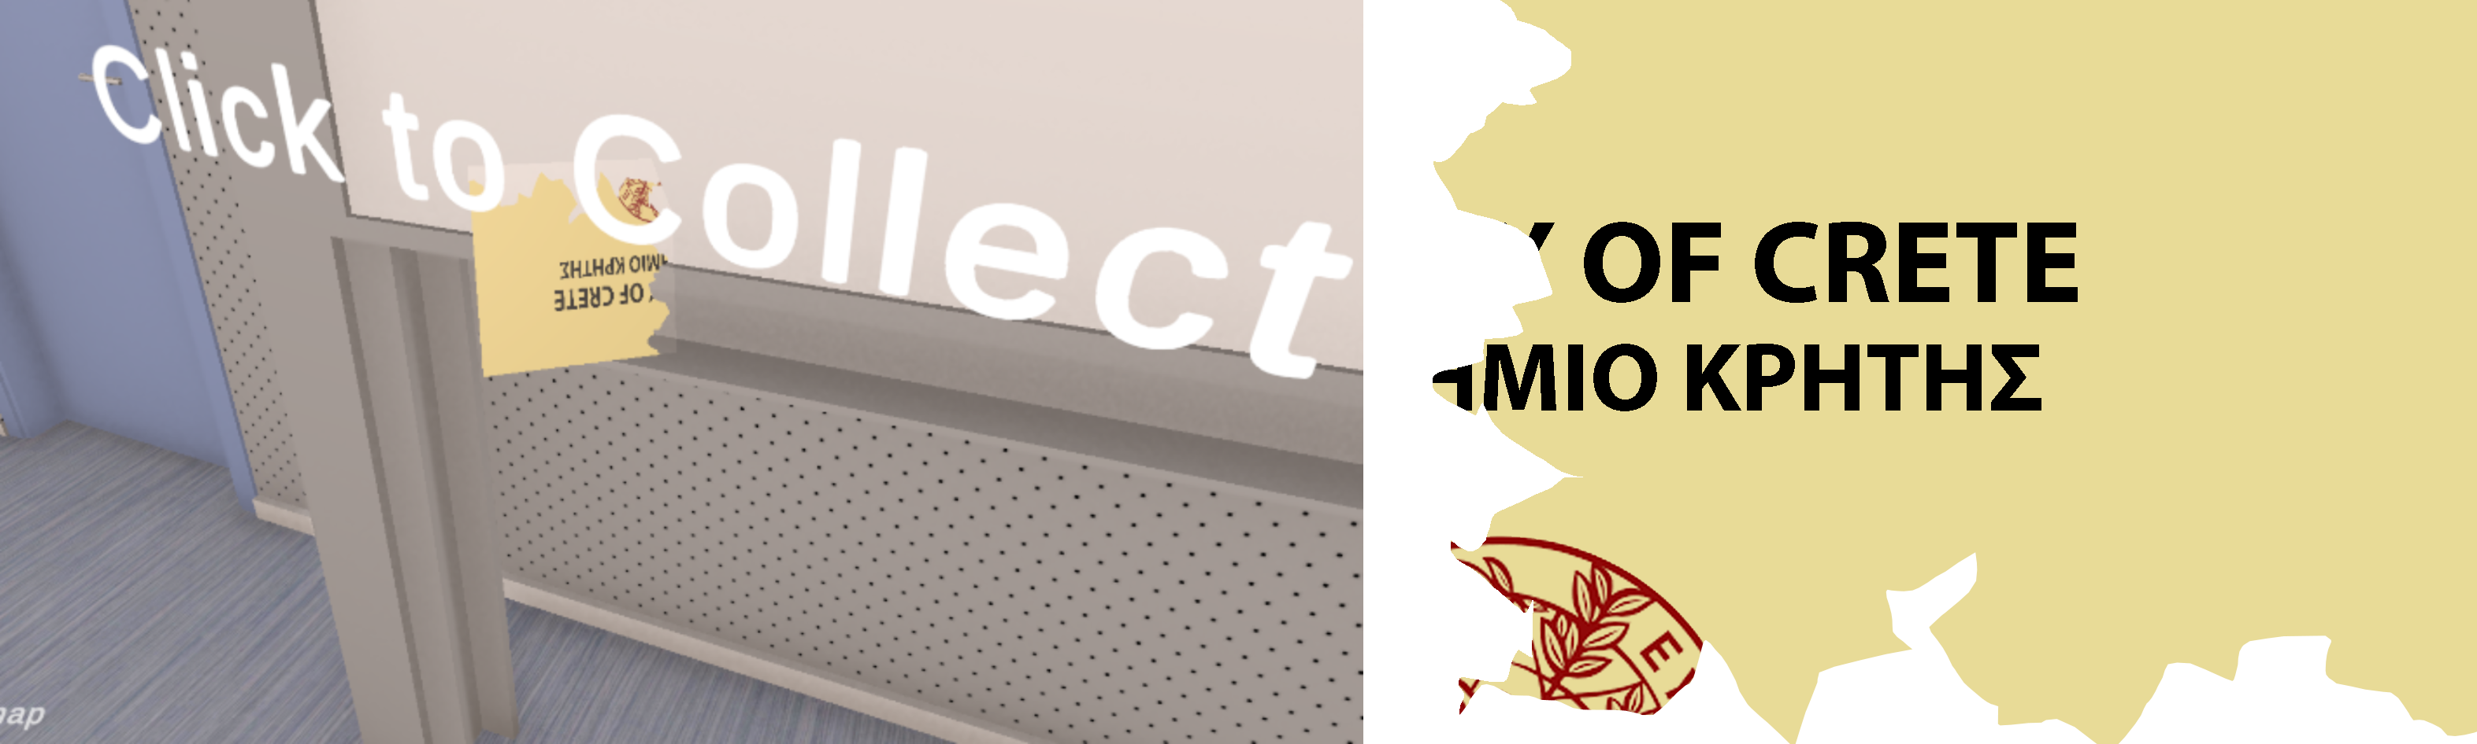
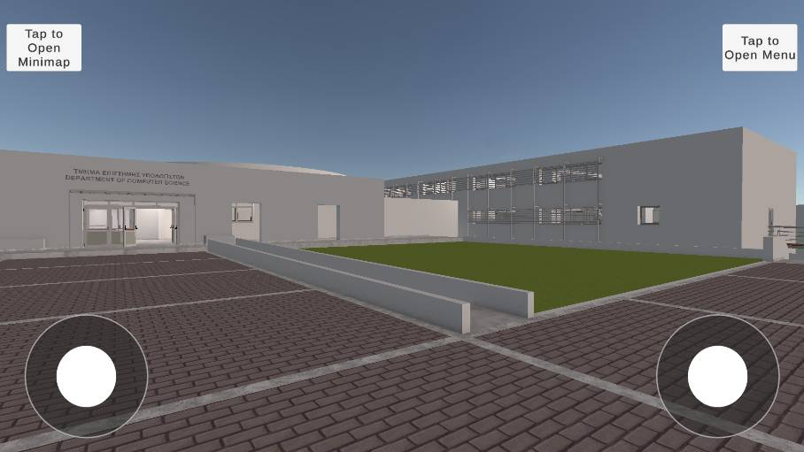
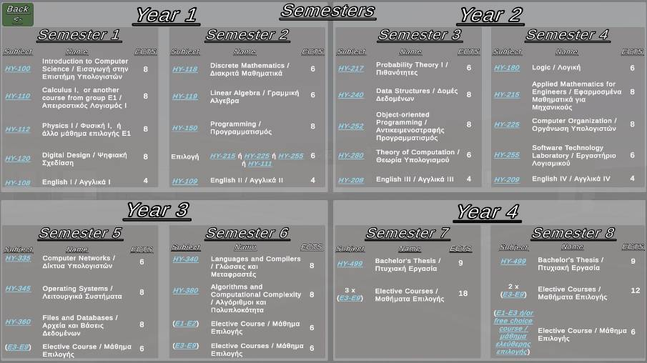
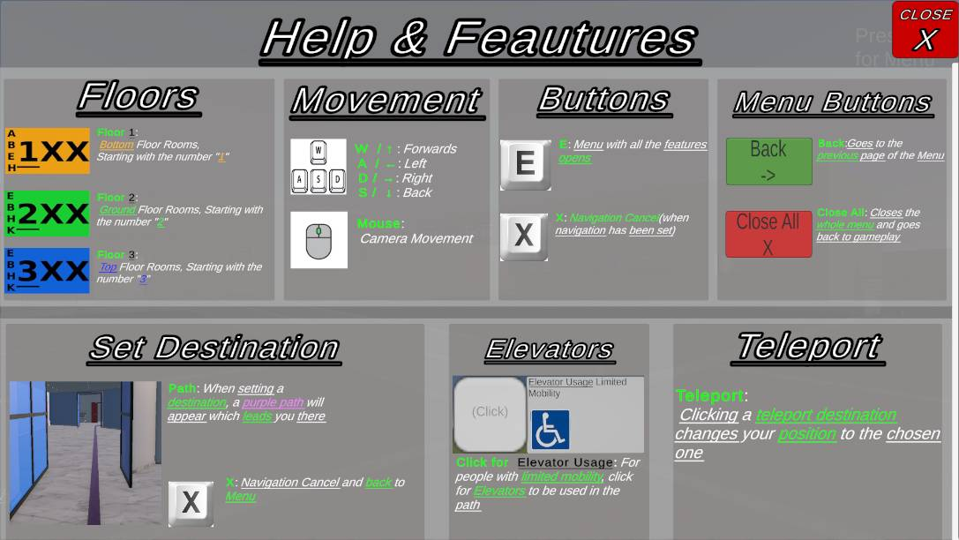
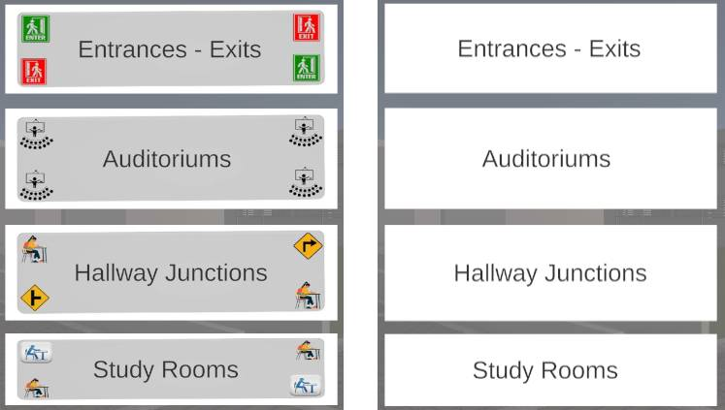
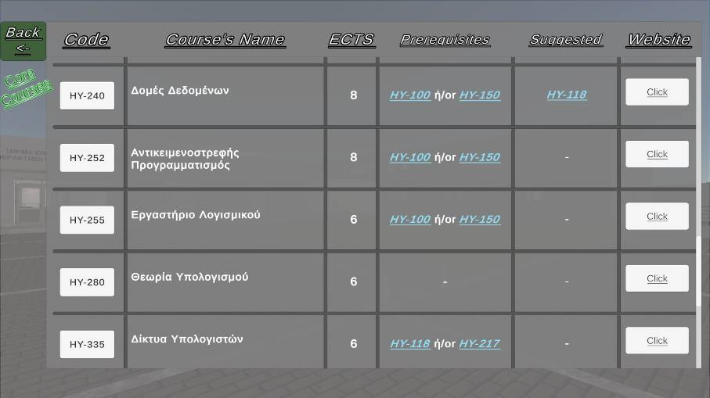
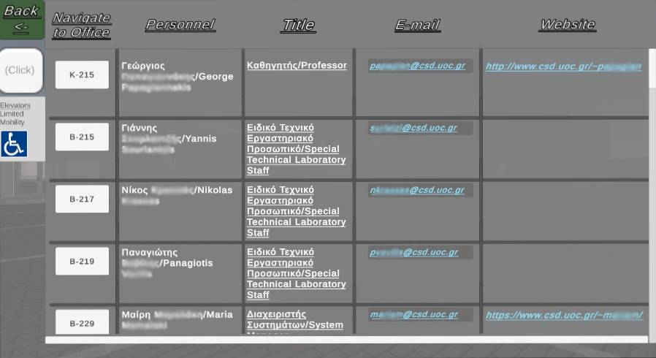
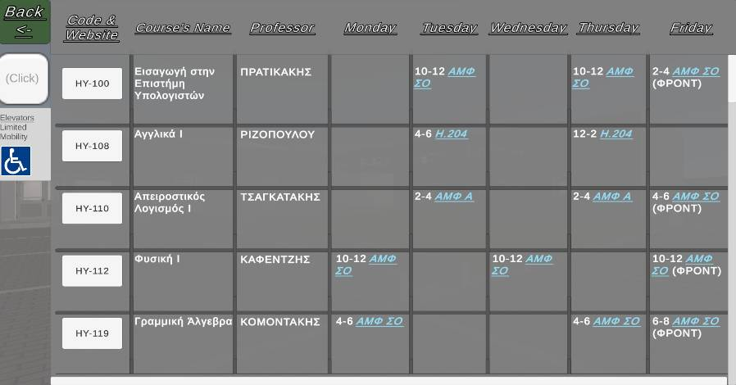
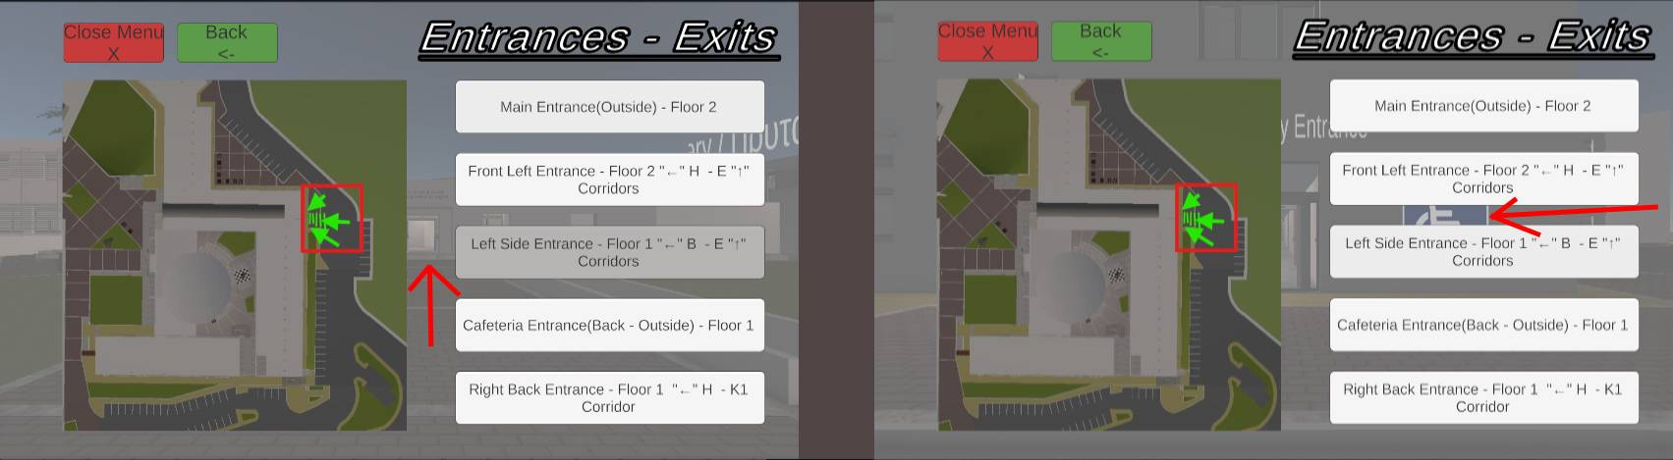

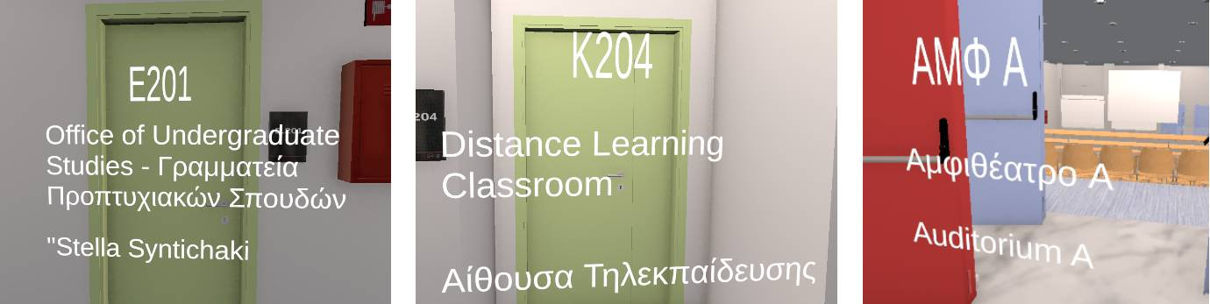
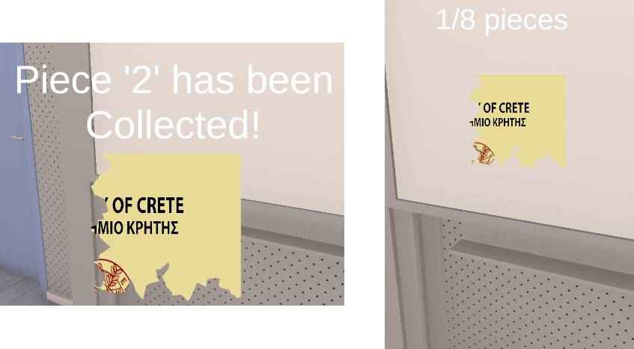
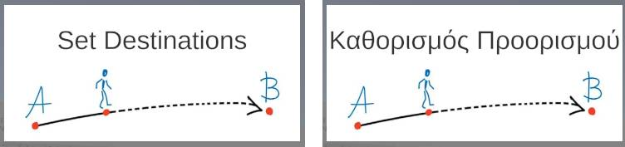
Features
The program offers a multitude of features:
Set Destination
Teleport
Limited Mobility – Elevator Toggle
Personnel Information
Semester Timetable
Subject Lists
Standard Curriculum
Hoverable Information
Colorful and Simplified Buttons
Greek and English Languages
Mini-Game
HELP Panel
Smartphone Usage

Slide 15
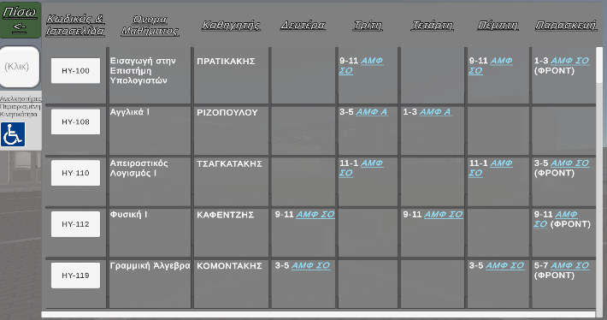
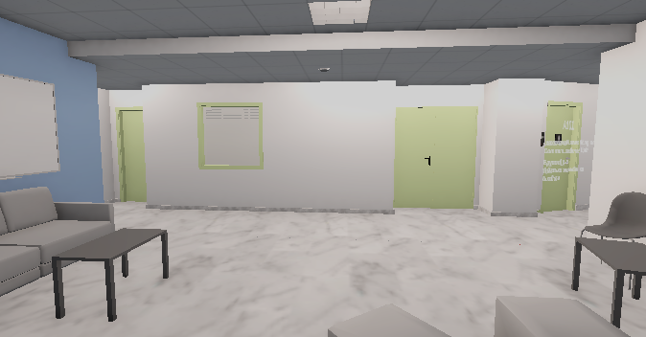
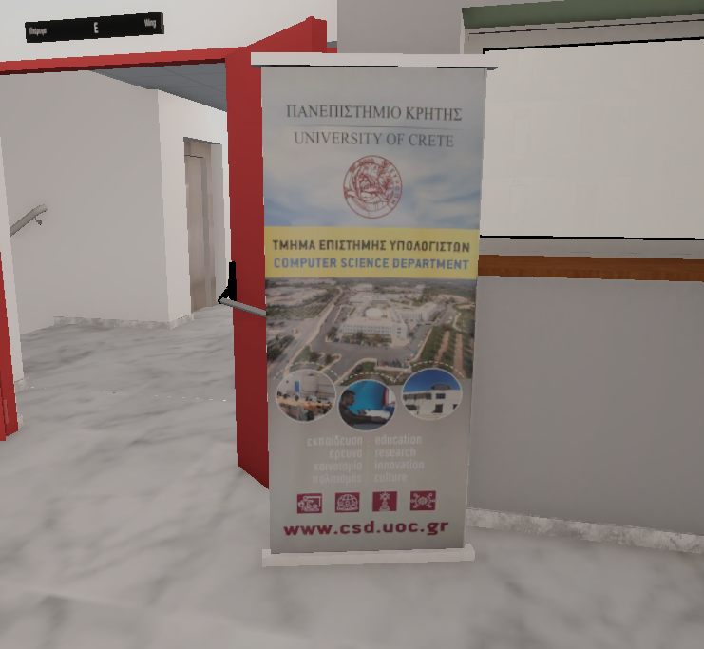
Is it Future Proof? Build to Last.
The program is built to last for many years:
All panels containing academic information, such as personnel information, timetables etc., receive their contents from public databases held in a Github repository.
Whoever is responsible for the databases can very simply alter any information they want and the program will automatically update its information.
The databases, as well as the repository itself, contain very explanatory information about the steps to be taken in order for smooth updates.
The building is already up-to-date, however, changes are easy to be made and the SketchUp file will also be given to the responsible personnel.

Slide 16
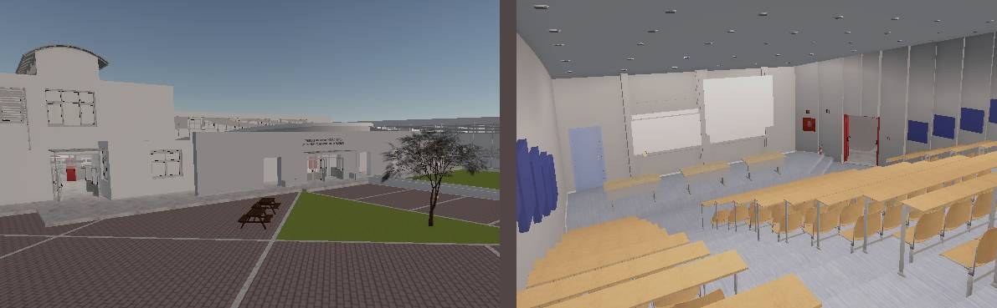
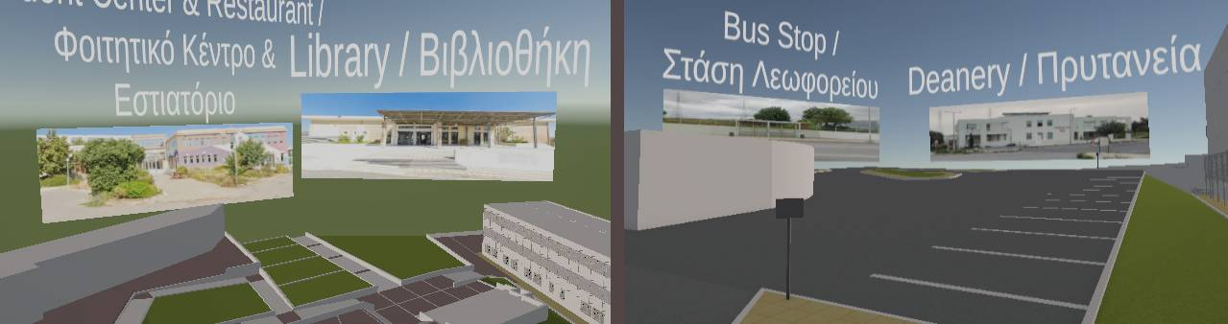
Free Roaming
The user can roam around the department’s area, inside and outside, and learn how to traverse, freely, without restrictions.

Slide 17
Set Destination
The users can set a destination to a huge number of provided destinations and begin a navigation towards there from their current position.

Slide 18
Teleport
Selecting a Teleport Destination changes the player’s position to that location.

Slide 19
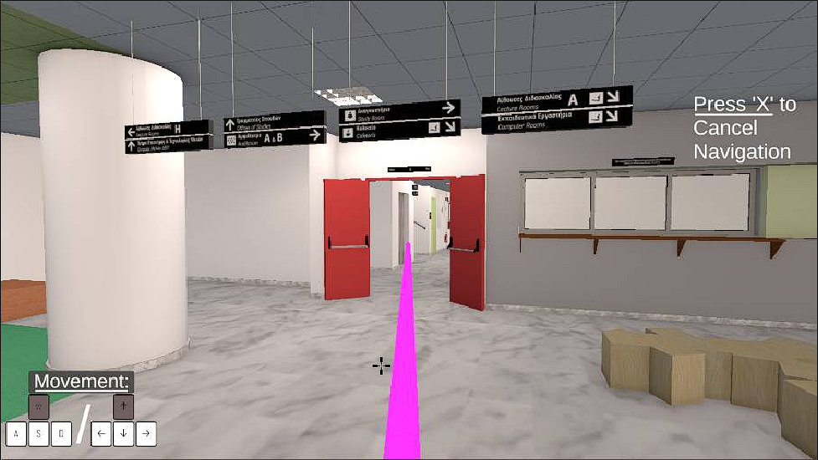
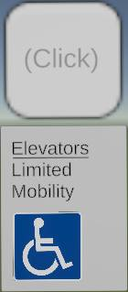





Limited Mobility – Accessibility via Elevators
The path is set and the user is taken to an elevator.
The user is greeted with the travel information and is teleported to the correct floor.
Horizontal Elevator Toggle, Checked.
Normal Path
Limited Mobility Path
When the user checks the limited mobility toggle at the Start Screen, they spawn to the official entrance for people with limited mobility issues.
The user reaches the new floor a navigation begins to the initial destination.
Vertical Elevator Toggle, Unchecked.

Slide 20
Personnel Information
Information about the department’s personnel is provided.

Slide 21
Timetable - Semesters
Information about the timetable/semesters is provided.

Slide 22

Subject Lists
Information about the department’s subject groups is provided.

Slide 23
Standard Curriculum
Information about the Standard Curriculum is provided.

Slide 24



Mini-Maps

Slide 25
Hoverable Text in front of Rooms

Slide 26



Player Movement & Sound Settings

Slide 27

Menu Navigation & Button Appearance

Slide 28
Language Change
User can change the language of all provided information to either Greek or English
The change can be done both at start and thought the usage of the program.

Slide 29
HELP Panel
The program also offers a HELP(Turorial) Panel containing all functionalities the program contains as well as how to use them.
Information about the player’s controls are also included there.

Slide 30
Mini-Game
A item-collecting Mini-Game also exists inside the world were users can collect hidden pieces to unlock a secret area and functionality.

Slide 31




Availability:
How long until the program is available for users to use?
The program is ALREADY available for users to use!!!
Users can visit the website below, both on PCs and Mobile Devices.
QR Code also takes you to the website.
https://csd3d.netlify.app/

Slide 32
Thank You!!!
Now Let’s go through a working Demo.

